Slide 1



Lecture 2: Developing with Unity / Unreal for
non-PC targets
COMP310 / COMP350: Algorithms & Optimisation
BSc Computing for Games

Slide 2
Today’s lecture:
PS4 development with Unity
PS4 development with Unreal
Android development with Unity

Slide 3
PS4 development with Unity

Slide 4
PS4 development with Unity
We have a version of Unity for PS4 development
2018.2.0f2
No other versions of Unity will support PS4 targets
It’s part of Brian’s Hosted virtual environment

Slide 5
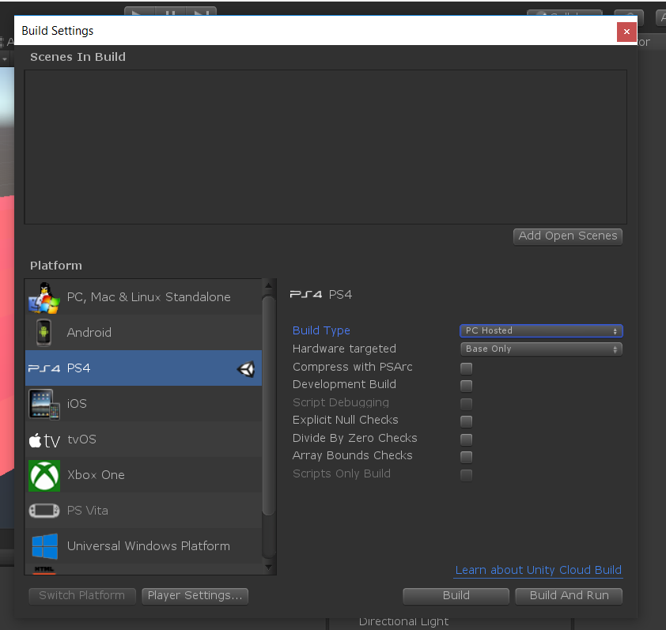
PS4 development with Unity
Let’s make a PS4 build of something
I’ll use a simple Brackey demo from the interweb
Set the build target to PS4
Build type is PC hosted (it’s easiest to work with
Hardware is ‘Base Only’ to give widest support
Build will create PS4 assets
Build & Run will deploy to your current target

Slide 6
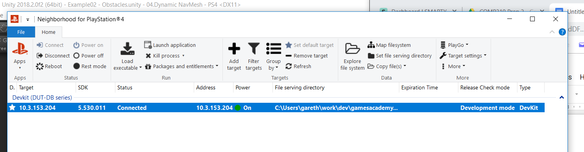
PS4 development with Unity
Let’s make a PS4 build of something
Run ‘Neighborhood for Playstation 4’ to choose a target
Unity’s build & run will use this as the build target
& will run app as soon as the build has suceeded

Slide 7
PS4 development with Unity
Let’s debug a running PS4 build
Good luck with that.
Unity doesn’t seem to support source-level debugging of C#
Fall back to normal Unity behaviour
Develop & test in editor
Run and evaluate on target

Slide 8
PS4 development with Unity
Debug.LogWarning() as a window into your code’s execution
Can use LogWarning to see what’s going on by peppering code with LogWarning(“is my code working”) type statements
View them in the console output (from Neighborhood for PS4 -> Apps)

Slide 9
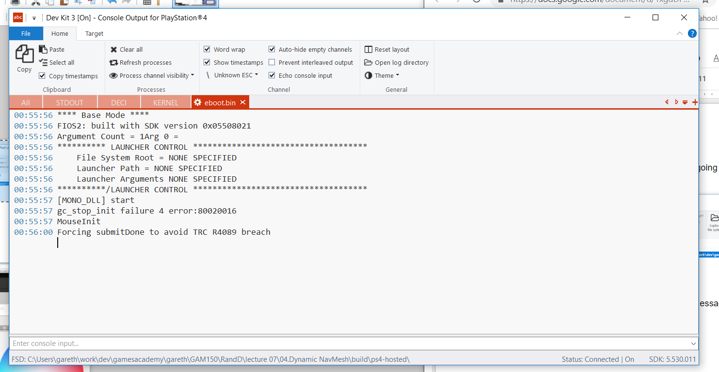
PS4 development with Unity
Debug.LogWarning() as a window into your code’s execution
View them in the console output (from Neighborhood for PS4 -> Apps)

Slide 10
PS4 development with Unity
Debug.LogWarning() as a window into your code’s execution
View them in the console output (from Neighborhood for PS4 -> Apps)
This is not ideal as LogWarning() includes entire callstack (just like the editor)
Can use networking code to manage better logging experience
See COMP260

Slide 11
PS4 development with Unity
DIY Network logging
PS4 App
(Server)
PC App
(Client)
Get ip address from application
Get ip address Neigborhood for PS4
Wait for connect from client
Connect to server
Serve client requests
Send log messages
Send requests

Slide 12
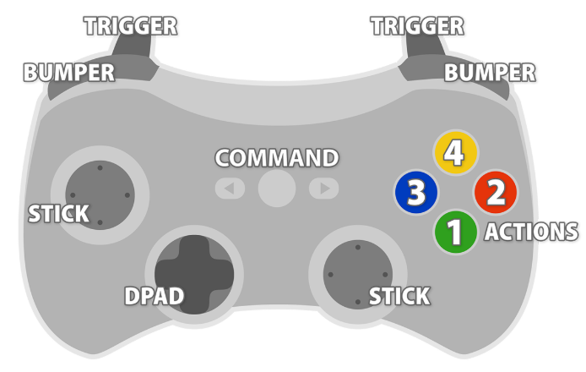
PS4 development with Unity
PC / PS4 differences
PS4 has different joypad configuration to PC/Xbox
Easiest thing to do is use InControl
AssetStore app that maps joypads to virtual configuration
Yes, it looks like an Xbox360 controller.

Slide 13
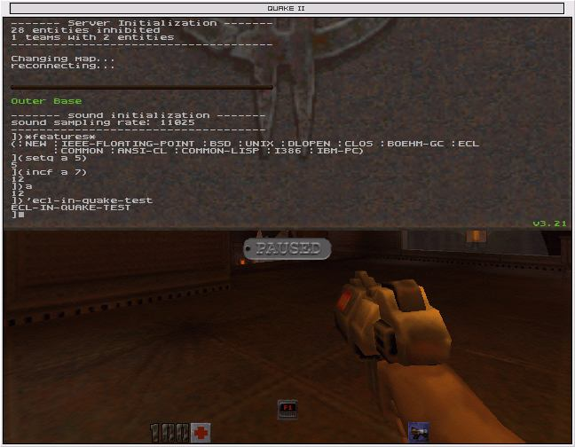
PS4 development with Unity
PS4 keyboard
PS4 supports PC keyboards using Unity input events
Worth thinking about using a keyboard to give you more control over your game on PS4
Copy debug keystrokes from PC builds
Build debug menu system to control game attributes
Build debug console (a la ID applications)

Slide 14
PS4 development with Unreal
There are three ways to deploy your project
Launcher
Cook by the book
Cook on the fly

Slide 15
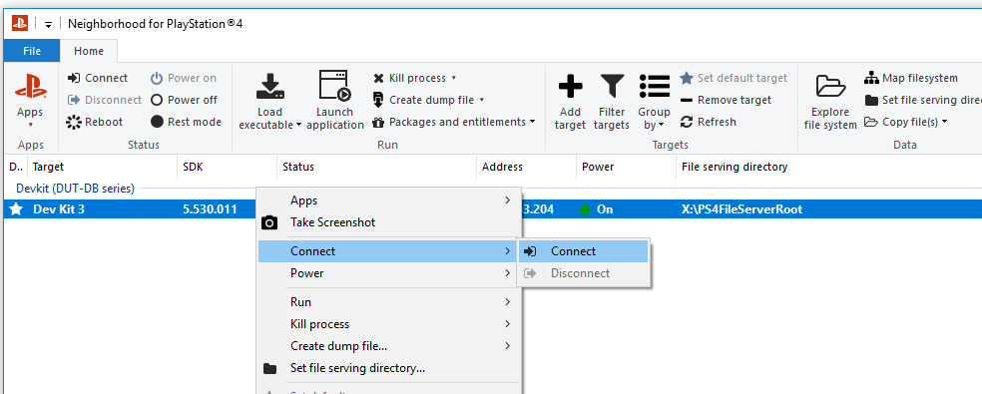
PS4 development with Unreal
Regardless of deployment method you need to connect to the dev kit
Network Neighbourhood

Slide 16
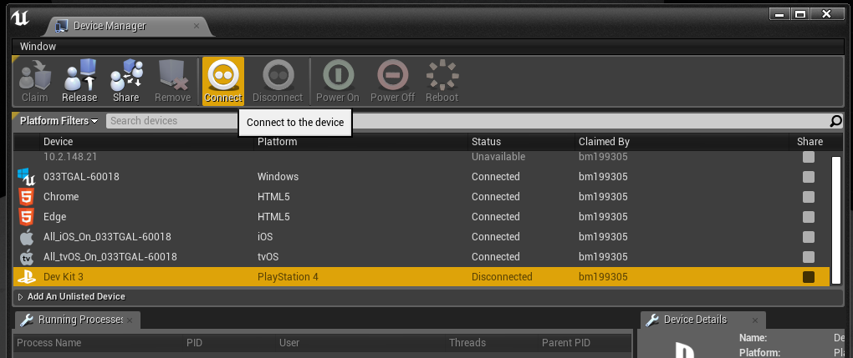
PS4 development with Unreal
Regardless of deployment method you need to connect to the dev kit
Device Manager in UE4

Slide 17
Deploy and Launch from the Editor
Open your project in UE4
Under the launch menu, select the Dev Kit
This will cook and then deploy your game to the PS4
This is the simplest but slowest for iteration
All content is included in the build, useful for content creators on small to medium sized projects

Slide 18
Cook On The Fly Server
Faster than Deploy and Launch
Requires you to build UE4Editor as development editor
This is then run from the command line, this will cook content as required
Recommended for large projects that the content is relatively fixed
Read from Stage Directory
Requires the most manual setup
Very similar to above, but
Recommended for large projects that the content is relatively fixed

Slide 19
Read from Stage Directory
Faster than Deploy and Launch
Recommended for large projects that the content is relatively fixed

Slide 20
Android development with Unity

Slide 21
Android development with Unity
Unity also supports Android / iOS development
Android is ‘easier’ as you don’t need a Mac as part of the build process
This link explains what to do to install Android SDK
https://docs.unity3d.com/Manual/android-sdksetup.html
Includes adding Android Studio

Slide 22
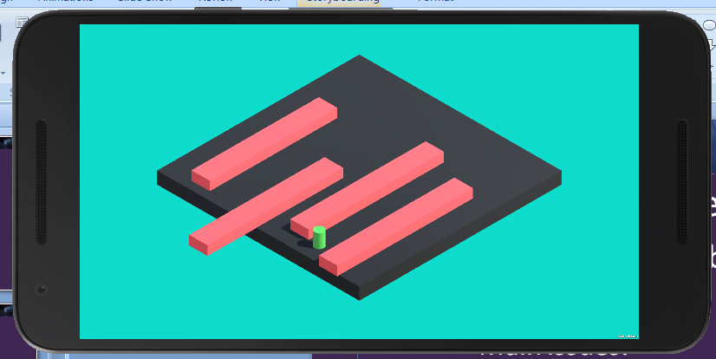
Android development with Unity
Once installed, set build target to Android and build
Main development issues:
Remembering to set up Package Name
Starting emulator / attaching phone

Slide 23
Android development with Unity
Once installed, set build target to Android and build
Main run-time issues:
Making content fit in app
Screen orientation
Performance
User interface

Slide 24
Developing for non-PC targets
Regardless of platform, all of these issues will be ideal to ‘document your porting process’ (Assignment 2, section B)

Slide 25
Questions?

